Slide 1
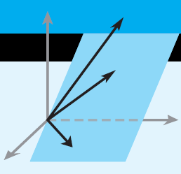
Elementary Linear Algebra
Howard Anton Copyright © 2010 by John Wiley & Sons, Inc.
All rights reserved.
Notes:
*

Slide 2
Chapter 1 Systems of Linear Equations and Matrices
1.1 Introduction to Systems of Linear Equations.
1.2 Gaussian Elimination ( in a separate PPT file).
1.3 Matrices and Matrix Operations ( in a separate PPT file).
Notes:
*

Slide 3
1.1 Introduction to Systems of Linear Equations
a linear equation in n variables:
a₁,a₂,a₃,…,a_{n}, b: real number
a₁: leading coefficient
x₁: leading variable
Notes:
(1) Linear equations have no products or roots of variables and
no variables involved in trigonometric, exponential, or
logarithmic functions.
(2) Variables appear only to the first power.

Slide 6
Every system of linear equations has either

Slide 7
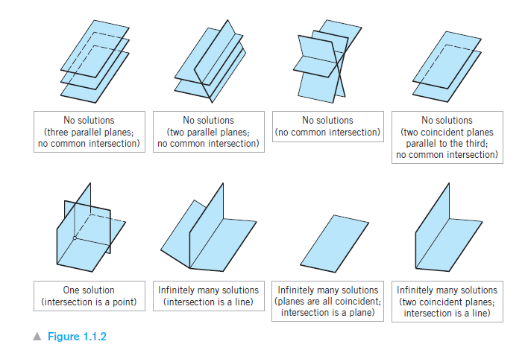
Linear Systems in Three Unknowns (Read)
Notes:
*

Slide 8
Homogeneous Systems: is the system where all equations are set = 0. ( b=0)
Theorem 1.2.2 A homogeneous linear system with more unknowns than equations has infinitely many solutions
Notes:
*

Slide 9
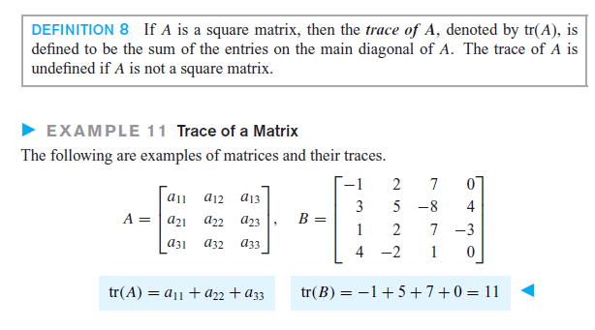
Trace of a matrix
Notes:
*

Slide 10
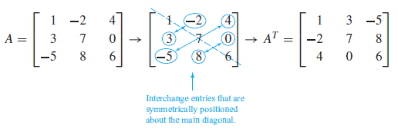
Transpose of a Matrix A^{T}
Notes:
*

Slide 11
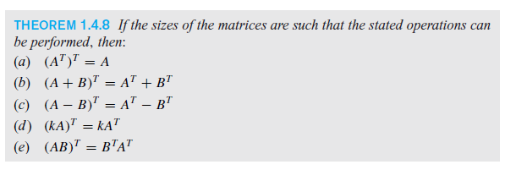
Transpose Matrix Properties
Notes:
*

